Slide 1

One stage image detection
YOLOv3 and YOLOv4

Slide 2
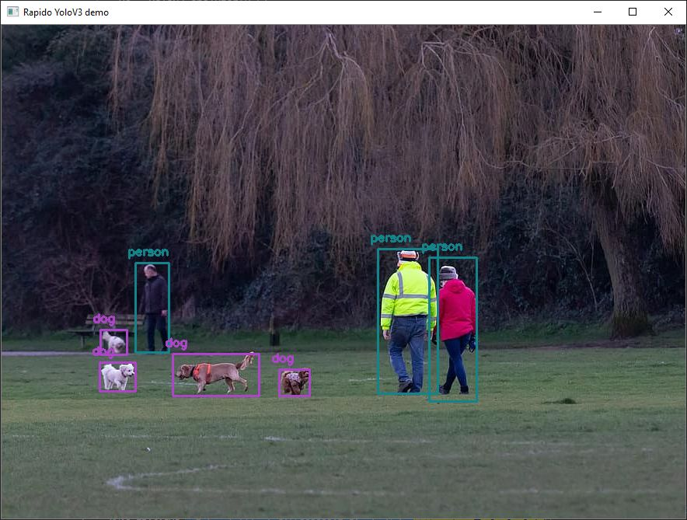
What is object detection ?
Aims to identify:
The class of an object (pedestrian, car, …)
Its position in the image with a bounding box

Slide 3
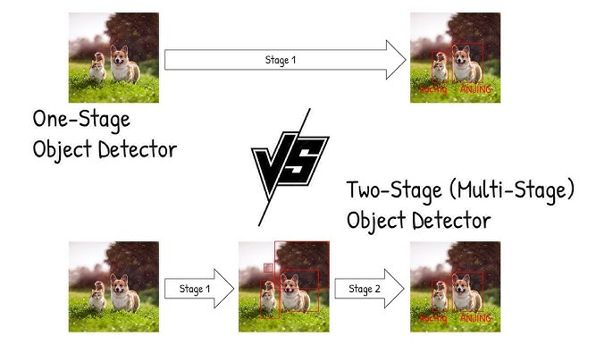
Two stages vs one stage detection
One stage does it all directly: it predicts bounding boxes and classes in one step (ex YOLO)
→ Makes them much faster so more adapted to real time applications
Two stages: (ex R-CNN)
Generate region proposals
Then, classify and refine these regions

Slide 4
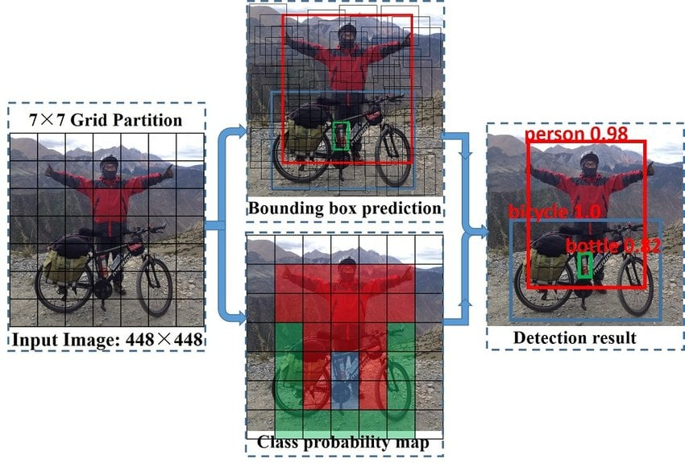
General principle of YOLO
YOLO = You Only Look Once
YOLO processes the whole image in a single forward pass
The image is cut into a grid
Each part of the grid is responsible for an item if the item is centered in his part
Then, the bounding box, the confidence score (is there really an object here) and the class probability (car?, dog?, person?, …) are determined

Slide 5
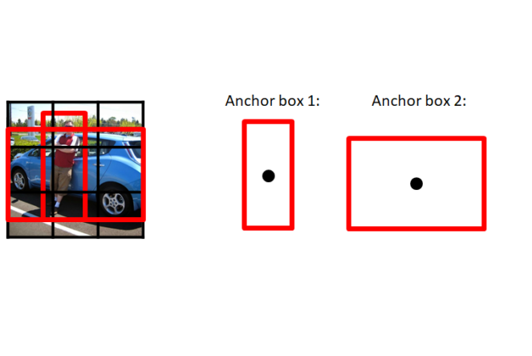
Anchor boxes
Anchor boxes are predefined reference boxes used to help predict objects with different shapes
Ex:
Person → usually tall and narrow
Car → usually wide
Instead of predicting a bounding box from zero, the model “cheats” starting with these anchor boxes, adjusting width and height

Slide 6
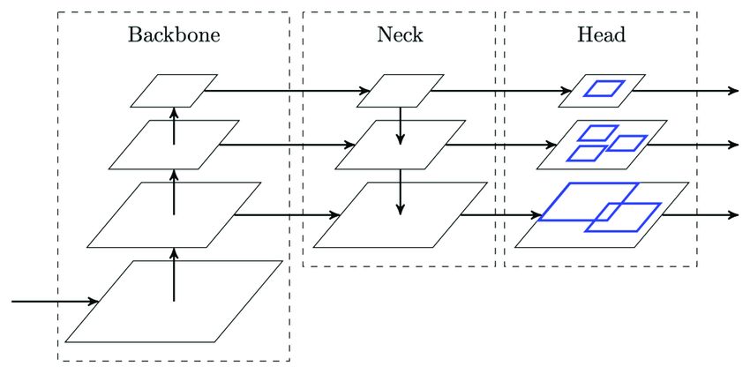
YOLOv3 – General architecture
Backbone: extracts the useful visual information from the image (edges, shapes, colours…).
Neck: reorganize information extracted by the backbone. Essential to detect small and large objects at the same type, by combining detailed information of early layers, and global information from deep layers.
Head: finalizes detection by predicting bounding boxes, confidence scores and classes
For YOLOv3:
Backbone: Darknet-53 (53 convolutional layers)
Neck: Feature Pyramid Network
Head: predictions at three different scales

Slide 7
YOLOv3: main improvements
Layer 1 → Layer 2 → Layer 3 → Layer 4
helps information flow through the network
This means we reinject not only the result of the last layer, but we can reuse older information
Darknet-53 backbone
skip connections inspired by ResNet
detection at three scales
9 anchor boxes
sigmoid instead of softmax for class prediction.
Class | probability
person | 0.92
woman | 0.87
dog | 0.04
car | 0.02
Class | Proba-bility
person | 0.80
woman | 0.15
dog | 0.03
car | 0.02
Sigmoid enables multi-label feature : Person + Woman
Sum > 1
Sum = 1

Slide 8
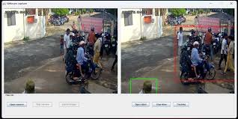
Limitations of YOLOv3
Limitations:
Still struggles with small objects
Difficulty in crowded areas
Improvements still possible on bounding boxes, training and optimization

Slide 9
YOLOv4: differences with its previous version
Aims to surpass YOLOv3 with better accuracy through enhancing architecture and training techniques
improves feature extraction and reduces unnecessary computation: information flow is divided in 2 branch, one going through layers and the other keeps its information to be merged later
helps the model capture context at different spatial scales: the bigger scale sees it’s a car and smaller ones will catch the details. It allows the model to look at both local details and larger surrounding regions.
Backbone: CSPDarkNet53
Neck: SPP + PAN
Head: similar to YOLOv3
improves information flow between shallow and deep feature layers: better than YOLOv3 because the flow is bidirectionnal

Slide 10
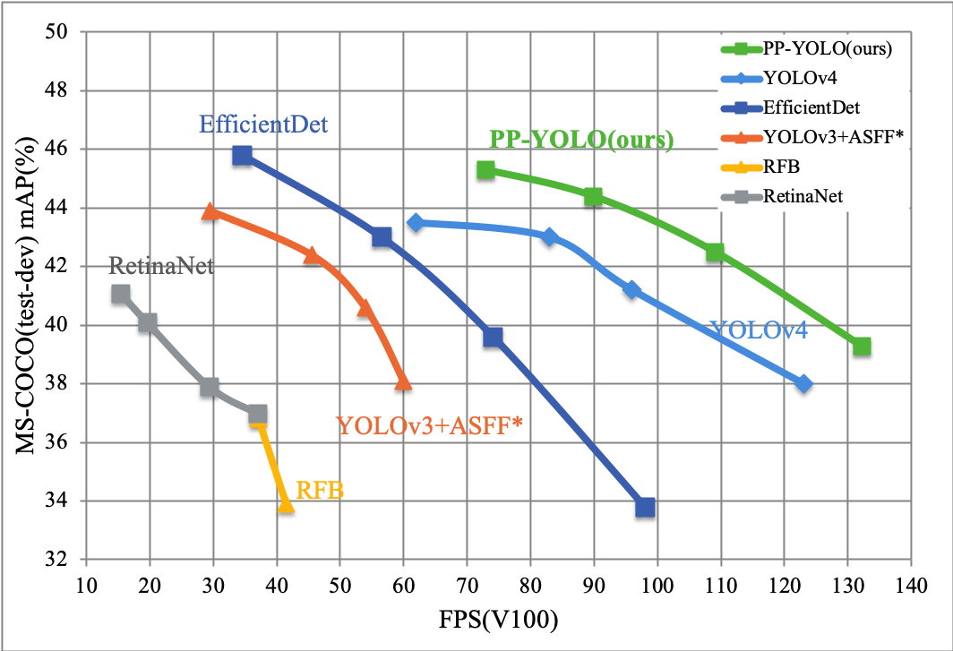
Other improvements of YOLOv4
Many other techniques implemented such as:
Mosaic Augmentation
DropBlock
Label Smoothing
Self-Adversarial Training
CIoU Loss
better hyperparameter optimization.

